Slide 1
Brief Review of My Research Programs: Fusion Diagnostics and Plasma Simulations
Xinhang Xu
PhD USTC (2016-2023)
Postdoc UC Davis (2024-Present)
For SRTT FEAT Position
October 9, 2025
Notes:
Good morning! Thank you give me the opportunity to attend the interview. I am very excited about this meeting and to be honestly a little nerves , I am not sure what kind of form the interview will be, so I prepared a brief introduction of my research program until now. Should I give a brief report about my research ? 10 mintus

Slide 2


Research Overview
Simulation and Experiment

Slide 3
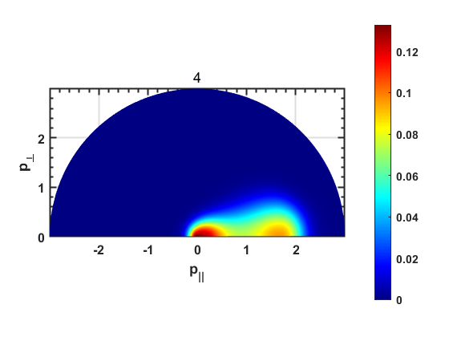
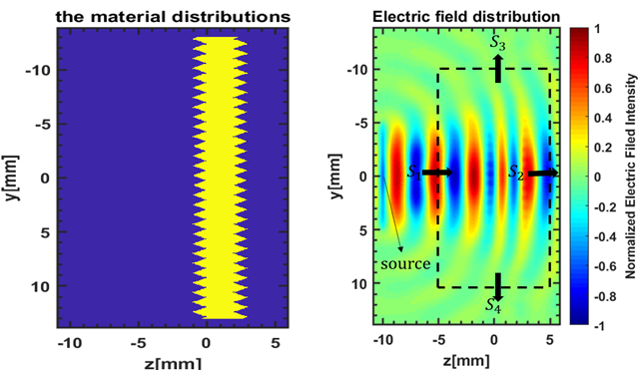
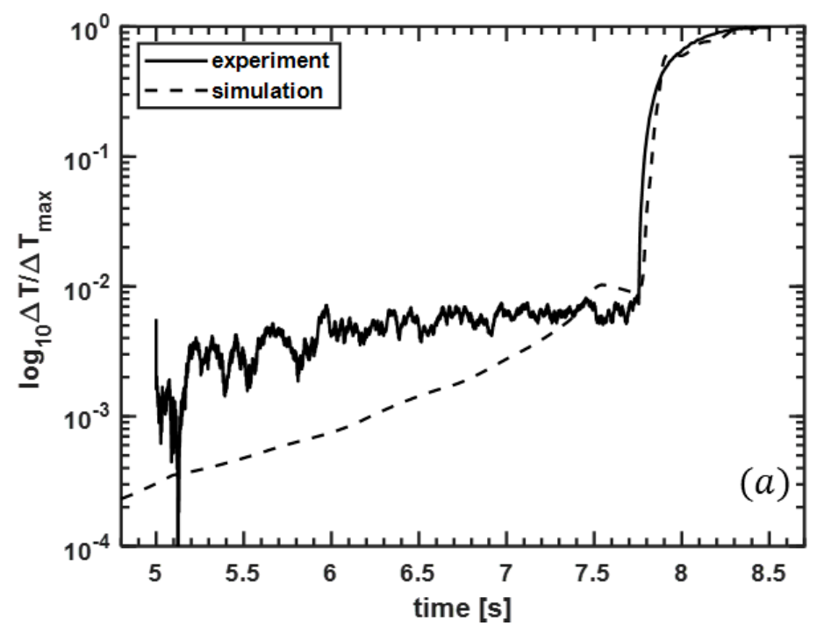
Works on simulations (During PHD at USTC)
From 2016-2023
Fork-plank Simulation
3D-ray tracing simulation
2D FDTD simulation
Synthetic Diagnostic
Mainly developed on MATLAB
Notes:
During my PDH period, I am going to break my research into two parts, simulation and experiment. For simulation part, I development 3d ray-tracing code for our ecei diagnostic system (object-oriented programming), so we can determined where the radiation comes from in the plasma, and we could have correct imaging position based on the ray-tracing code. The second simulation works is on the kinetic simulation, which demonstrate the electron velocity distribution evolution under plasmas environment. Since our electron cyclotron emission is sensitive to the electron cyclotron velocity, combined with our synthetic diagnostic, we can convert the electron velocity distribution to electron cyclotron emission intensity, and than we can compare with the experiment results, and analysis the hidden physics process for abnormal emission. And the last important simulation works for me is 2D FDTD to verify the transmission effect on grove surface. I know it can be down by software like HFSS and CST , but writing this program can help me to extend the simulation in the plasma environment. This is the main part of my simulation works.

Slide 4
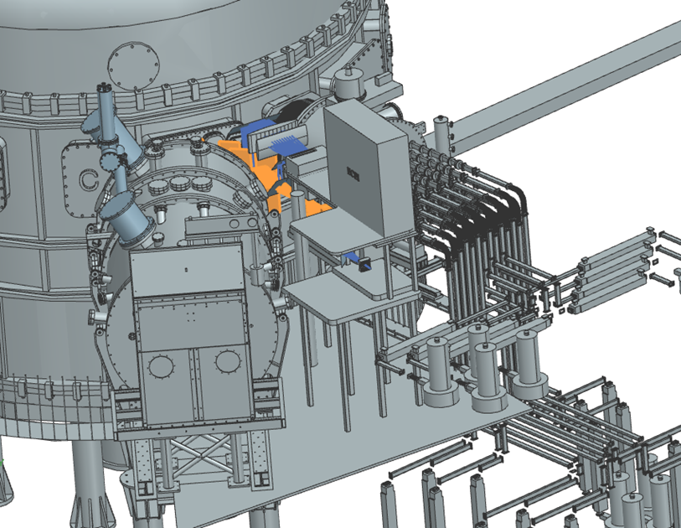
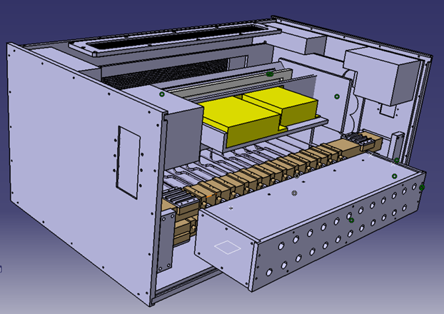
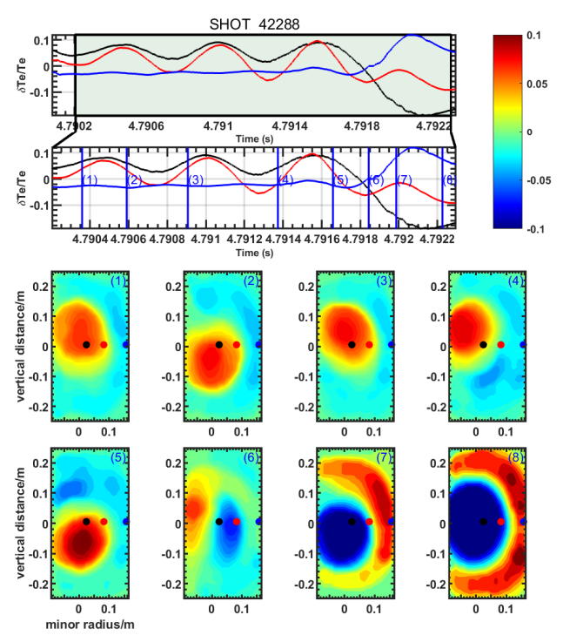
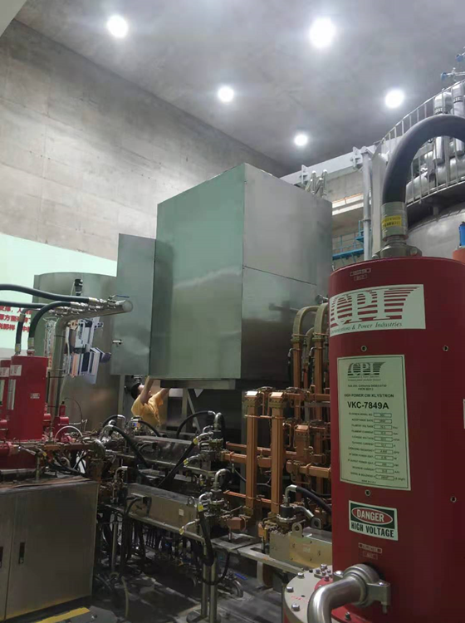
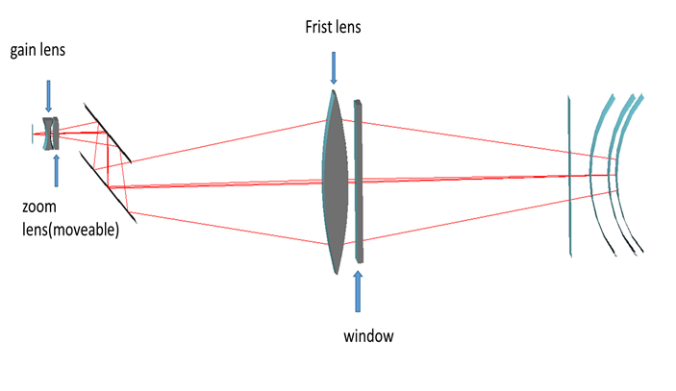
Works on Experiment (During PHD at USTC)
From 2016-2023
Design ECEI antenna Shielding Box
Design ECEI&MIR platform
Optical Design
Experiment data analysis
COMSOL Multiphysics, Catia, Code V
Notes:
My second part is about the experiment experience, This part includes the design ECEI and MIR platform in EAST hall, the antenna shielding box for ECEI, Optical setup for MIR illumination system and experiment data analysis. I am the main responsible person to take charge of the designation, fabrication and install the platform. Location of between …… contamination, well protected. The optical can shape the illumination wavefront curvature couple with cutoff surface in the plasma, so when we receive the reflect wave, we can avoid doppler shift from the rotation of the cutoff layer in the plasma.

Slide 5
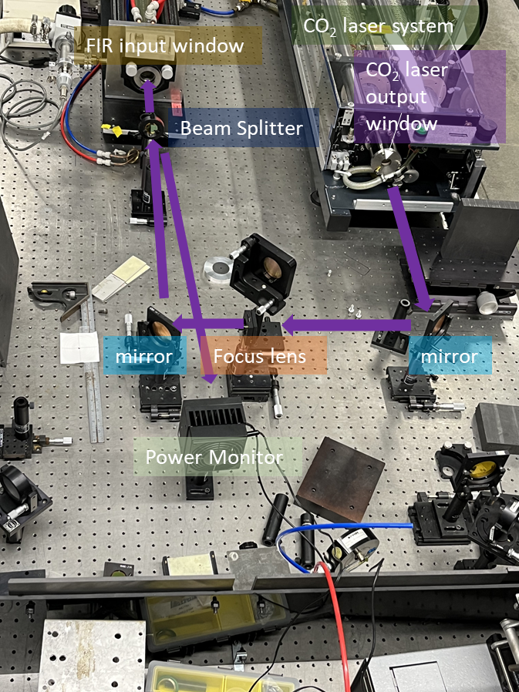
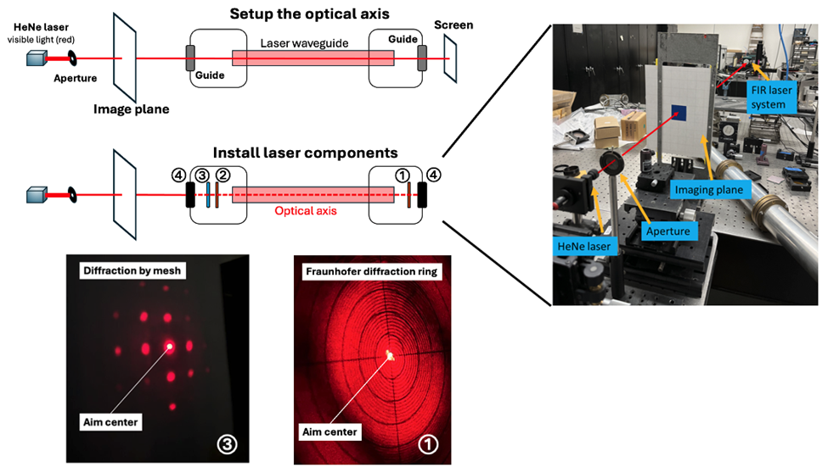
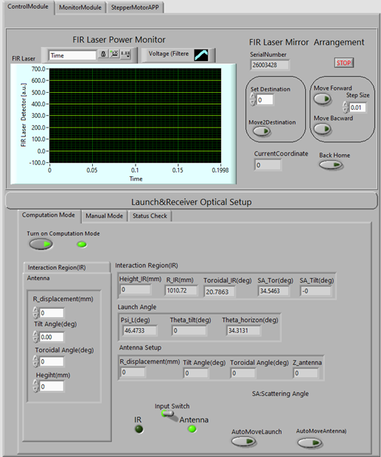
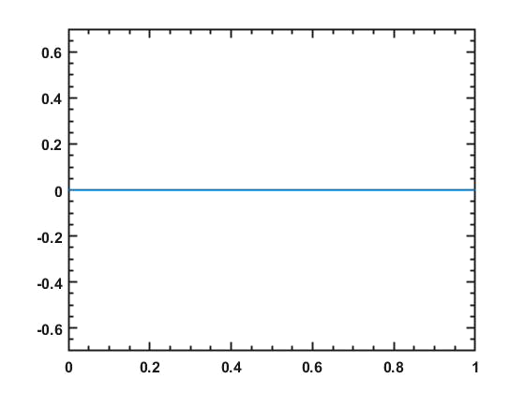
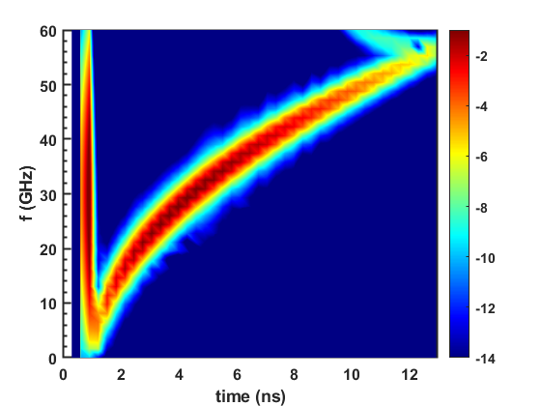
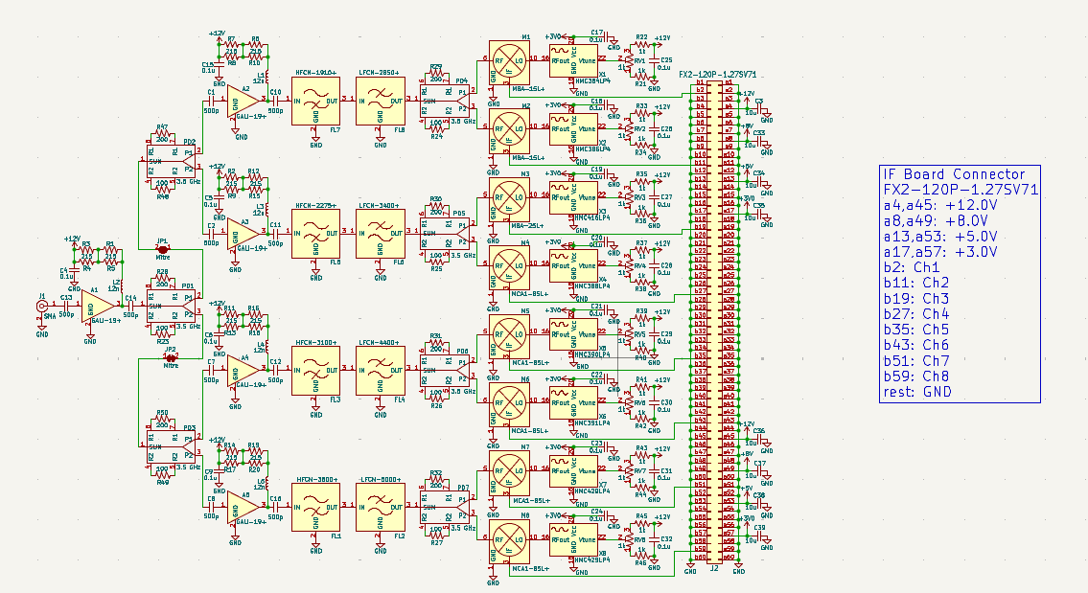
Works during Postdoc at UC Davis
From 2024-2025
High-k scattering laser design for NSTX-U
FIReTIP laser design for PPPL
1D FDTD simulation in plasma
RF board design for CTS on BEST
Ultra Short Plus Reflectometry simulation
E
z/m
Software: KiCAD, Python, LabVIEW
Notes:
The third part is working at UC Davis, mainly about two laser system: FIReTIP(Far-infrared Tangential Interferometer/Polarimeter) system and high-k scattering laser system. I worked on the laser optimization, laser control and optical alignment with our group team. I also written LaBVIEW program to control and monitor the laser operation and working parameters. I also written a FDTD code for simulating wave propagation in the plasma, for example this is one example for simulation the ultra short plus reflectrometry simulation. So we can analysis experiment results under different plasma profile.

Slide 6
Part of Publishing Papers
Facility | Diagnostic | Contribution | Publication
EAST | ECEI/MIR | Synthetic/Data analysis | PST, RSI
NSTX-U | High-k Scattering | Laser development | RSI 2025 (Second review)
DIII-D | ECEI/MIR | Simulation/data analysis | JPP 2024
BEST | CTS | RF board design
Notes:
I hope my experience and knowledge can contribute to your company and works together for our fusion dream.

Slide 7
My unique skills:
Experience bridging simulation and experiment (FIReTIP, ECEI,USPR)
Active involvement in the development of various plasma diagnostic systems.(ECEI, MIR, USPR, High-k scattering system, FIReTIP)
Strong expertise in plasma simulation.(Kinetic simulation for runaway electron, FDTD, Synthetic diagnostic for ECEI and 3D Ray-tracing code)
Abundant experience on data analysis

Slide 8
Thank you !

Slide 9
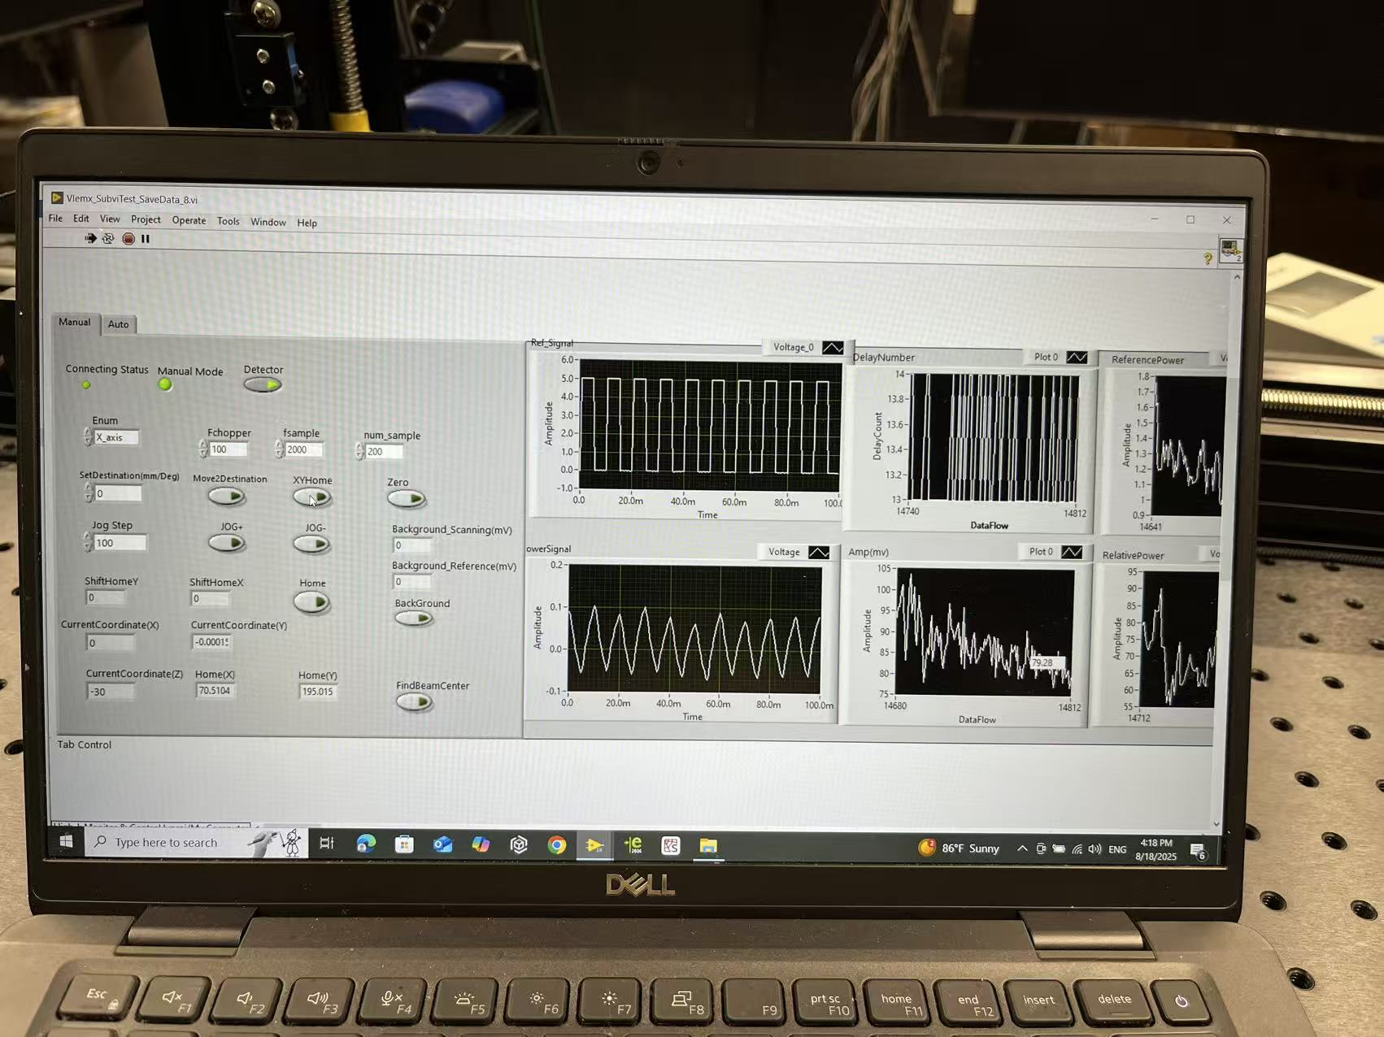
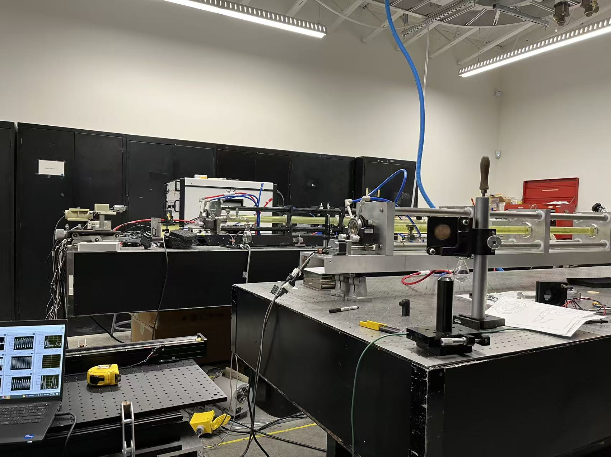
THz Laser Room in UC Davis :

Slide 10
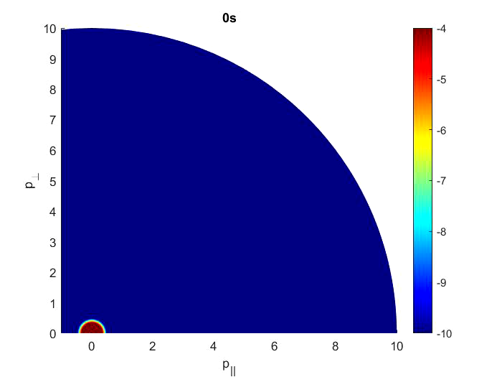
Kinetic simulation works

Slide 11
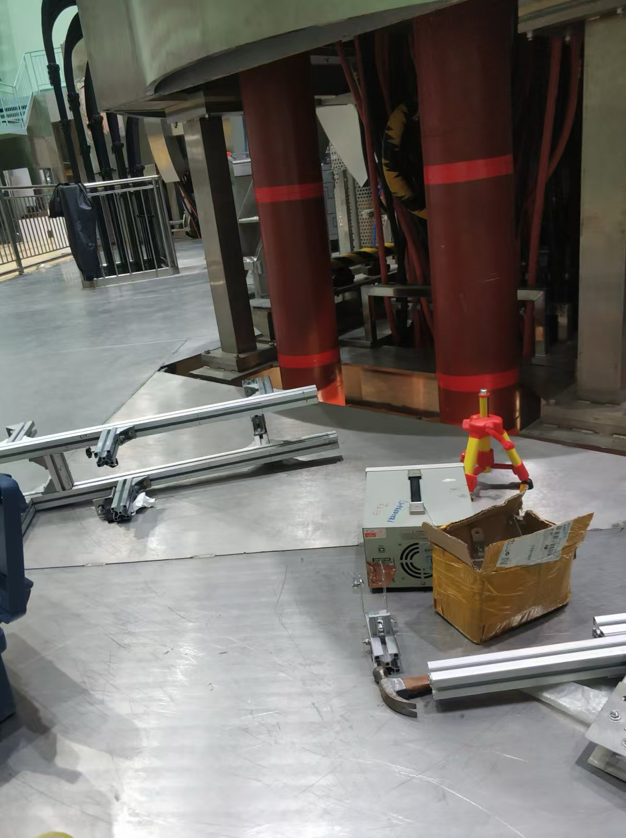
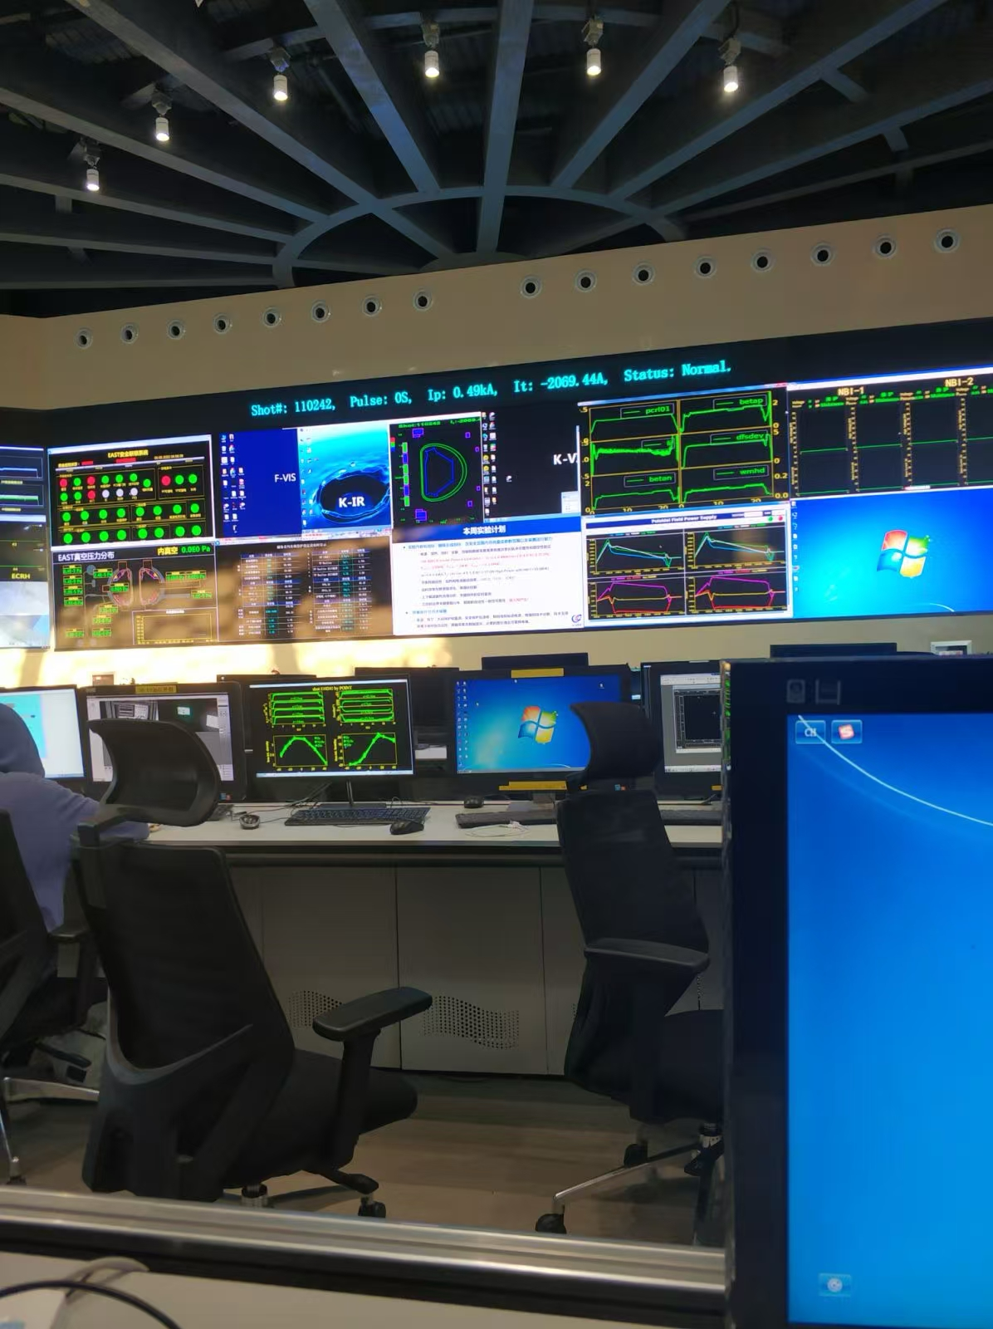
EAST experiment
Notes:
Impressive time

